Slide 1
Do enhancer-associated intergenic long noncoding RNAs contribute to nuclear architecture ?
Cyril Matthey-Doret
Supervised by : Jennifer Yihong Tan
Directed by : Ana Claudia Marques

Slide 2
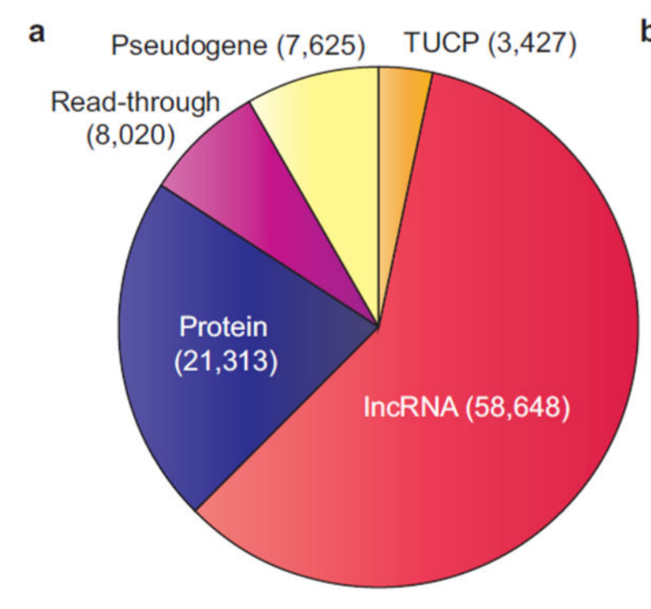
LncRNAs
Long noncoding RNAs
Defined based on length : >200bp
Largest class of noncoding transcript in the human genome
Iyer MK et al., 2015. Nat Genet.
Notes:
It was only 15 years ago that it was found large portion of the transcriptome do not code for proteins
LncRNA do not encode proteins, >200bp etc
More than 3 times greater than pcgenes

Slide 3
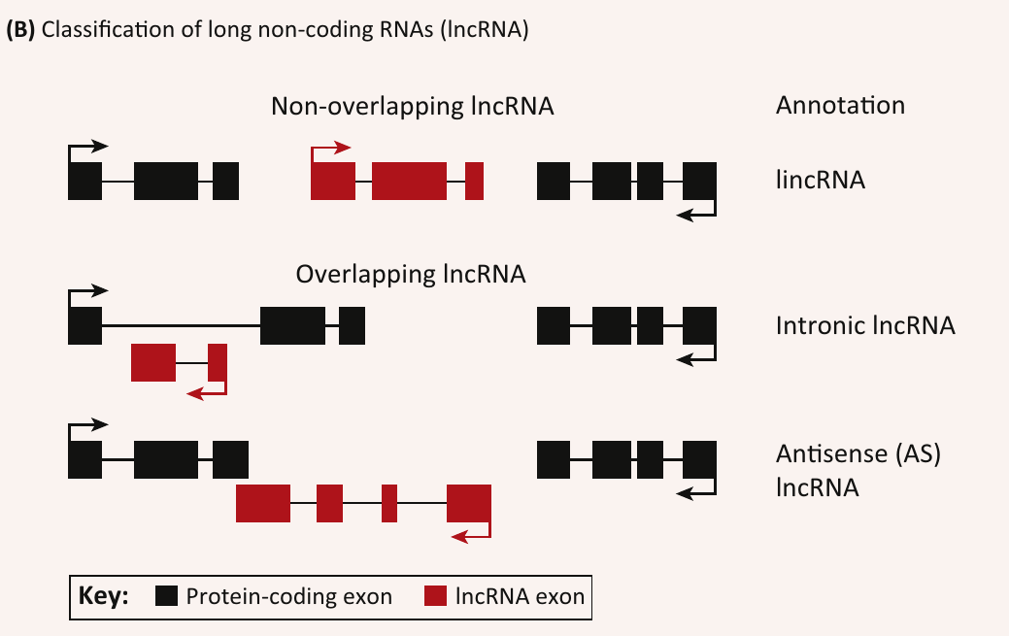
LincRNAs
Long intergenic noncoding RNAs
Do not overlap protein coding genes
Largest class of lncRNAs
Atianand MK, Fitzgerald KA, 2014. Trends Mol Med
Notes:
In particular, intergenic lncRNAs are the most abundant within lncRNAs

Slide 4
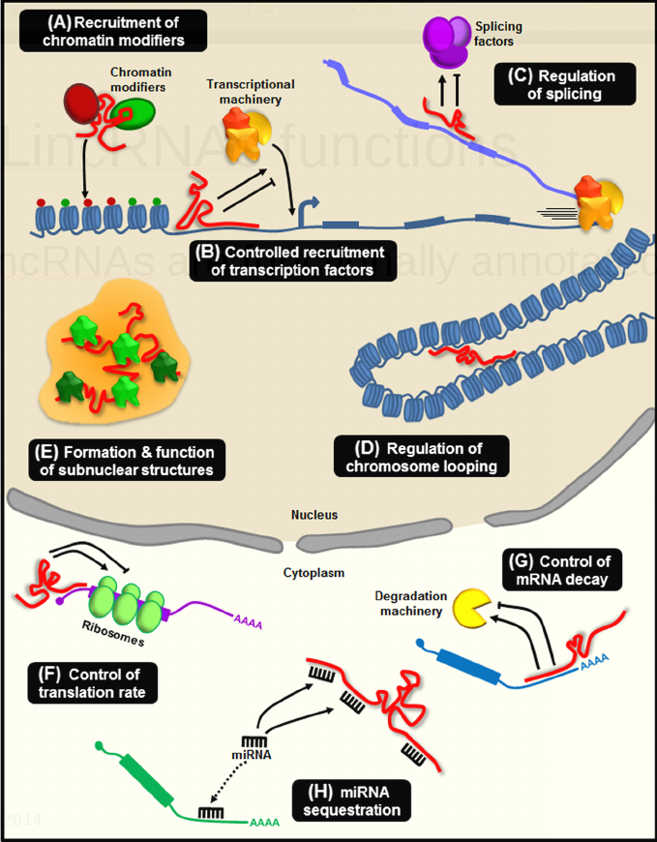
LincRNAs functions
Only 294* lncRNAs out of ~60,000 are functionally annotated
Wide variety of functions
* February 2016, http://www.lncrnadb.org/
Neguembor et al. Skeletal Muscle 2014
Notes:
LincRNA are a very heterogeneous class of transcripts with diverse regulatory functions, both transcriptioanlly and posttranscriptionally in both the nucleus and cytoplasm
However, currently, only less than 300 are functionally characterized, whether the majority of them have any functional roles are unknown

Slide 5
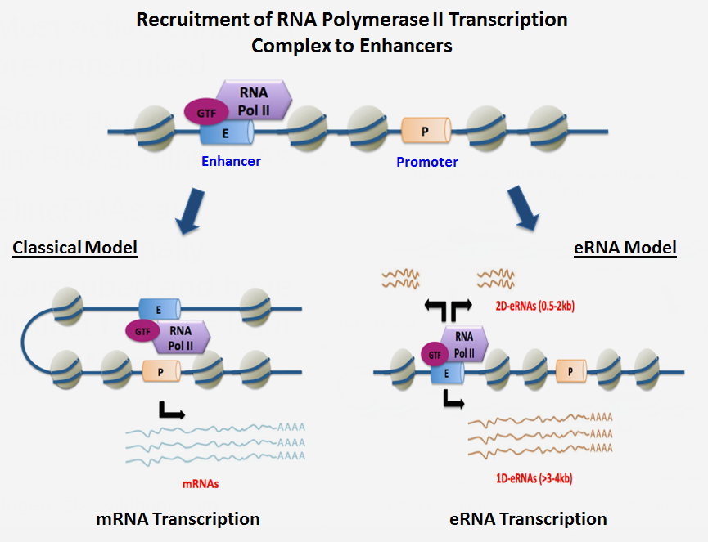
elincRNAs
Most active enhancers are transcribed
Some produce lincRNAs: elincRNAs
ElincRNAs are unidirectionally transcribed and have distinct features from 2D-eRNAs
eRNA Biogenesis, wikipedia.org
Notes:
One class of lincRNAs originate from active enhancers
It’s known that most active enhancers are transcribed
Most producing bidirectional RNAs – eRNAs
Some producing unidirectional elincRNAs
Explain the difference

Slide 6
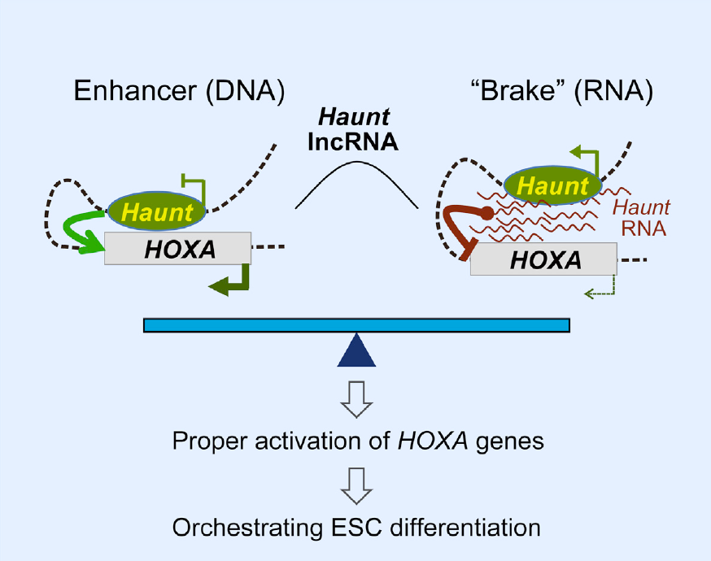
Example of elincRNA - Haunt
Haunt originates from enhancers - elincRNA
Modulate looping
Notes:
One example of an unidirectionally transcribed elincRNA originating from enhancers is Haunt
- which is involved in the regulation of chromosomal folding

Slide 7
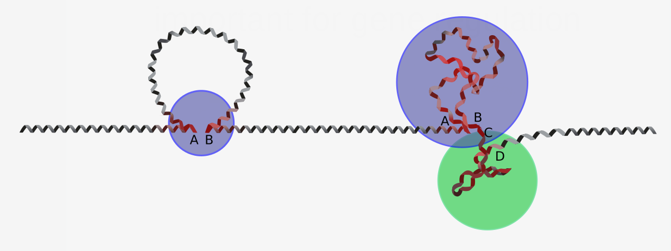
Chromosomal conformation is important for gene regulation
Chromatin can fold into compact structures regulating gene expression
Notes:
DNA is folded into compact structures within the nucleus
Chromosomal folding is important for gene regulation
For example, a distal enhancer maybe far from a gene in terms of linear distance, but is folded to promoter transcription of the gene

Slide 8
Project aim
Do all lincRNAs arising from enhancers have a role in the regulation of intrachromosomal contacts ?
Notes:
So the aim of my project is to investigate whether functionally characterized elincRNA, such as Haunt, are only examples of elincRNAs that are involved in regulating chromosomal interactions, or is this a general functional of all elincRNA?

Slide 9
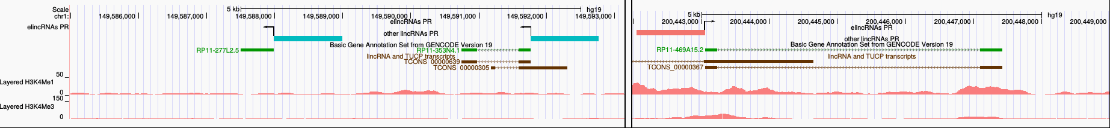
Data
ElincRNAs: LCL-expressed lincRNAs whose promoter region overlaps enhancers active in LCL (ENCODE)
Class | Overlap | Number
elinc | Enhancers only, no promoters | 236
other | Neither enhancers nor promoters | 1756

Slide 10
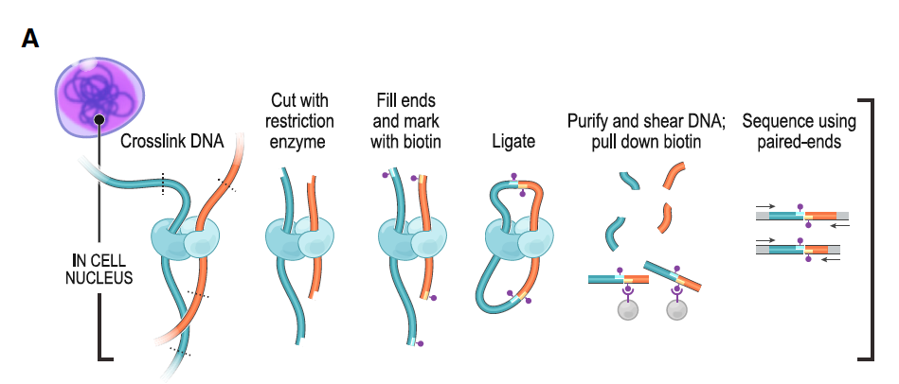
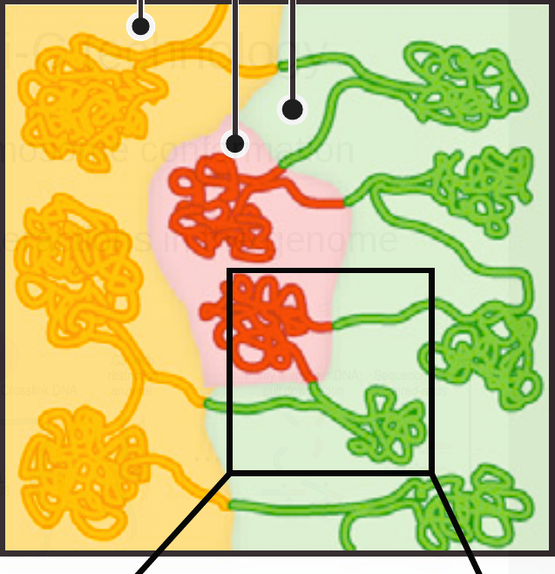
Method: Hi-C technology
Genome-wide chromosome conformation capture
Allows to map all interactions in the genome
...
Rao et al, 2014. Cell
Notes:
DNA conformation is measured using the HiC technology

Slide 11
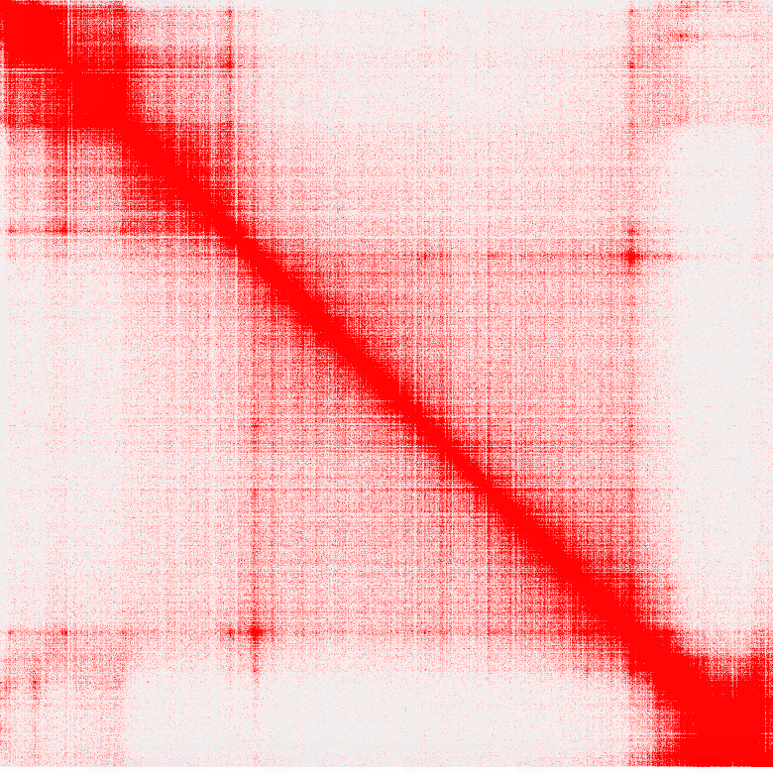
Method: Hi-C technology
Genome-wide chromosome conformation capture
Allows to map all interactions in the genome
Rao et al, 2014. Cell
Notes:
DNA conformation is measured using the HiC technology
- sequencing of interacting DNA within the same chromosome can then be built into matrix like this
This is matrix showing interactions across one chromosome
You can see clear substructures within this chromosome, where interactions are high
There are called topologically associating domains - TADs

Slide 12
Method: Hi-C technology
Genome-wide chromosome conformation capture
Allows to map all interactions in the genome
Topologically
Associated
Domains
Rao et al, 2014. Cell
Notes:
DNA conformation is measured using the HiC technology
- sequencing of interacting DNA within the same chromosome can then be built into matrix like this
This is matrix showing interactions across one chromosome
You can see clear substructures within this chromosome, where interactions are high
There are called topologically associating domains - TADs

Slide 13
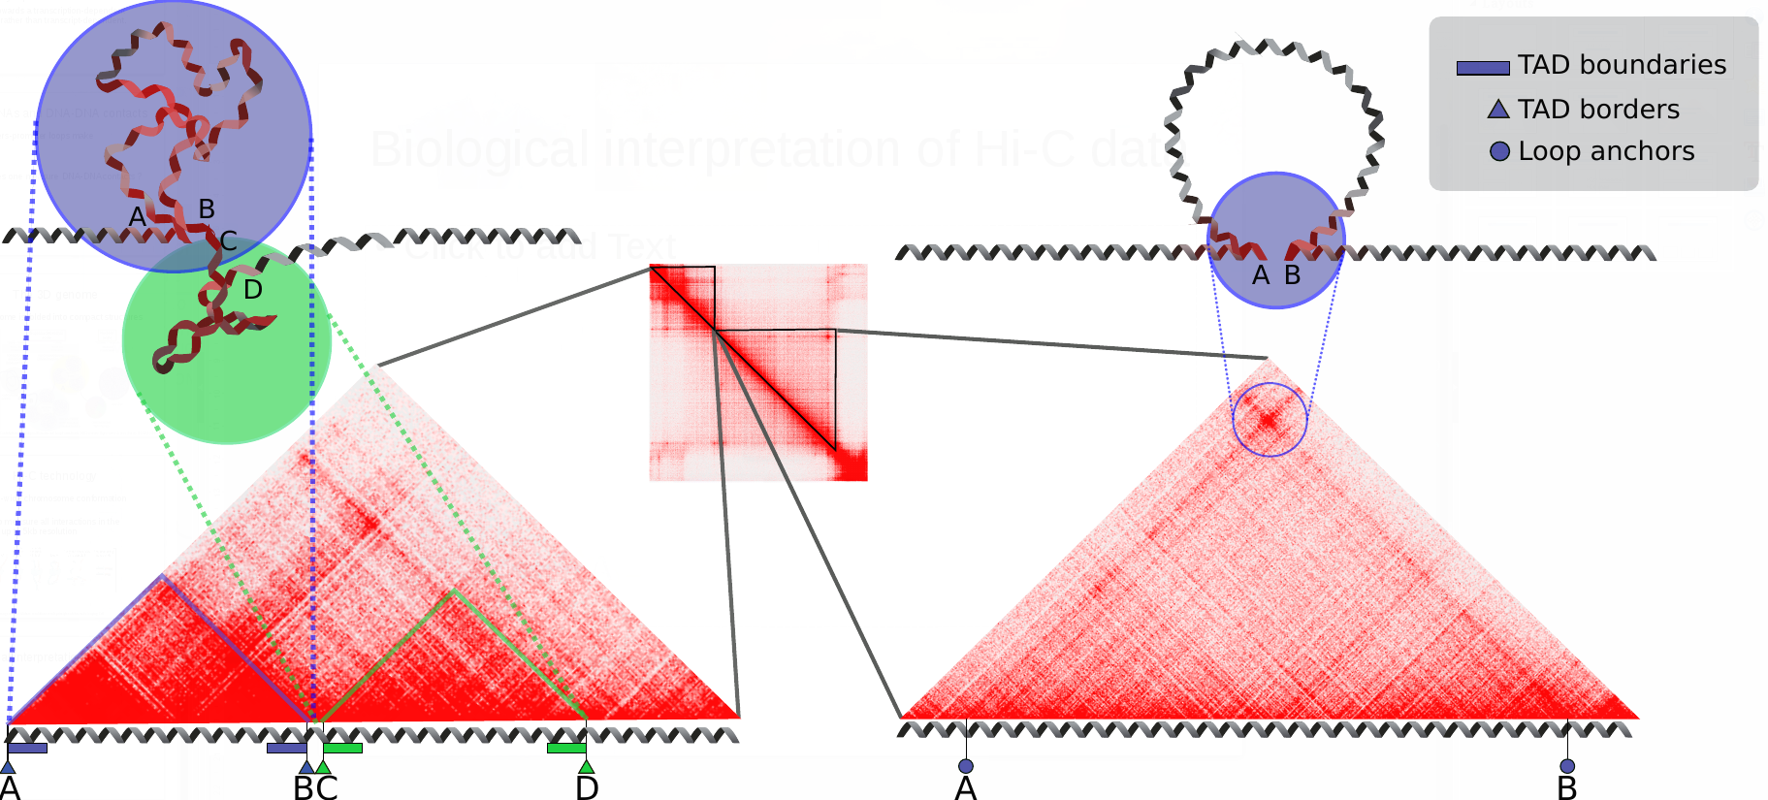
TAD structures important for gene regulation
TAD
Boundaries
Notes:
Within TADs, there are regions important for its structural and gene regulation
Including TAD boundaries, which block interactions across two different TADs
Loop anchors are where gene regulatory interactions between enhancers and promoters occur

Slide 14
TAD structures important for gene regulation
CTCF
Cohesin
Notes:
More importantly, CTCF and cohesin are 2 important regulatory proteins that are enriched at both TAD boundaries and loop anchors
Deletion of CTCF and cohesin can lead to misregulation of gene expression

Slide 15
Aim I
Are elincRNAs enriched in regulatory regions in TADs and loops ?

Slide 16
Loop anchors
Frequent promoter-enhancer interactions
CTCF
Cohesin
Notes:
Because of the associated enhancer activities of elincRNAs, first, I decided to look at whether elincRNAs are enriched at enhancer-promoter interactive loops ?

Slide 17
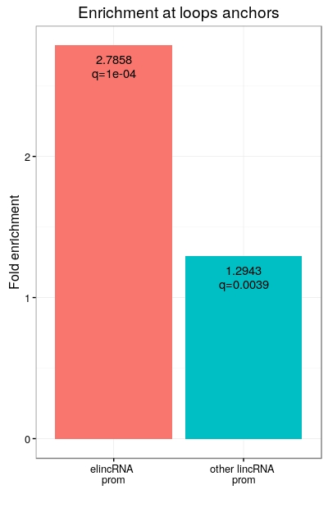
ElincRNAs are enriched at loop anchors
Promoter regions of elincRNAs are enriched at loop anchors compared to other lincRNAs
Consistent with their putative regulatory role
2.79
q=1e-04
1.29
q=0.0039
q : p-value adjusted for multiple testing
ElincRNA
prom
elincRNA
prom
other lincRNA
prom

Slide 18
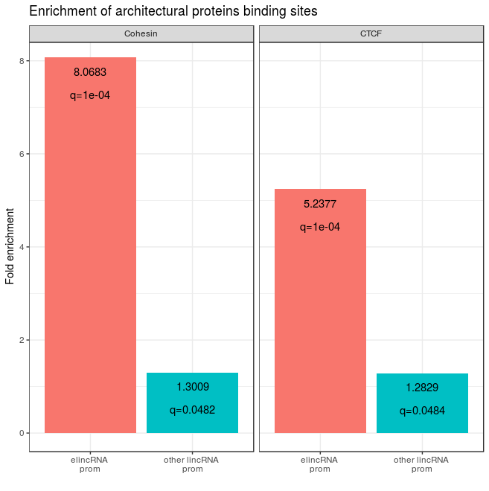
ElincRNAs enriched in architectural proteins
ElincRNAs are enriched in CTCF and cohesin (RAD21 + SMC3) binding sites.
8.06
q=1e-04
5.24
q=1e-04
1.30
q=0.05
1.28
q=0.05
elincRNA
prom
other lincRNA
prom
elincRNA
prom
other lincRNA
prom

Slide 19
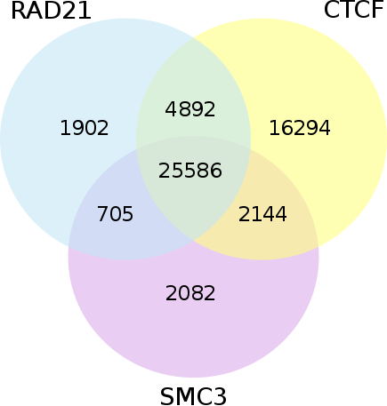
CTCF and cohesin peaks overlap
CTCF and cohesin peak regions largely overlap
Both proteins have different roles in TAD regulation
Is the enrichment still present at CTCF-only peaks ?

Slide 20
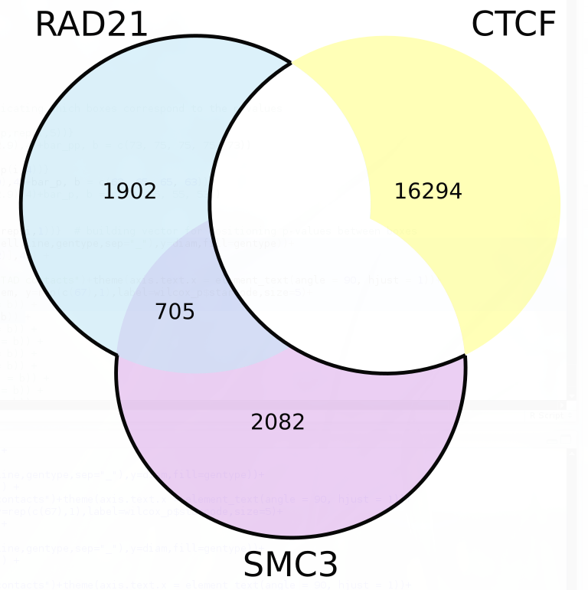
CTCF and cohesin peaks overlap
CTCF and cohesin peak regions largely overlap
Both proteins have different roles in TAD regulation
Is the enrichment still present at CTCF-only peaks ?

Slide 21
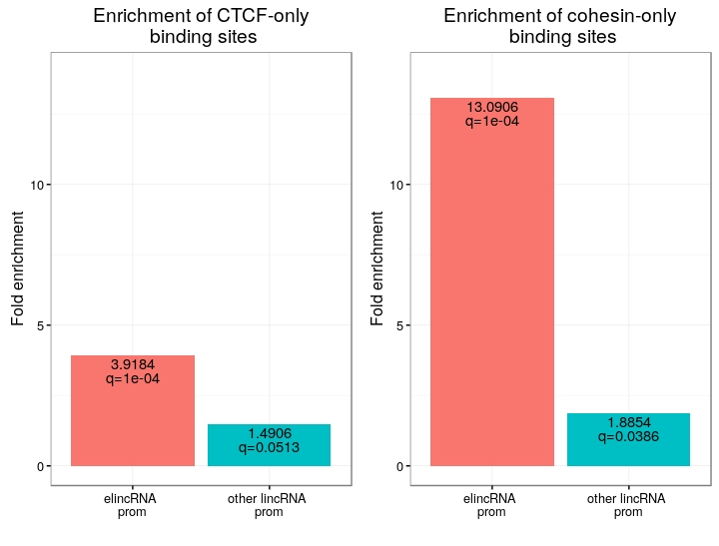
ElincRNAs strongly enriched in cohesin-only peaks
The promoter regions of elincRNAs show a very strong enrichment for cohesin-only peaks compared to other lincRNAs
This is not the case for CTCF peaks
13.09
q=1e-04
1.49
q=0.05
1.89
q=0.04
3.92
q=1e-04
elincRNA
prom
other lincRNA
prom
elincRNA
prom
other lincRNA
prom

Slide 22
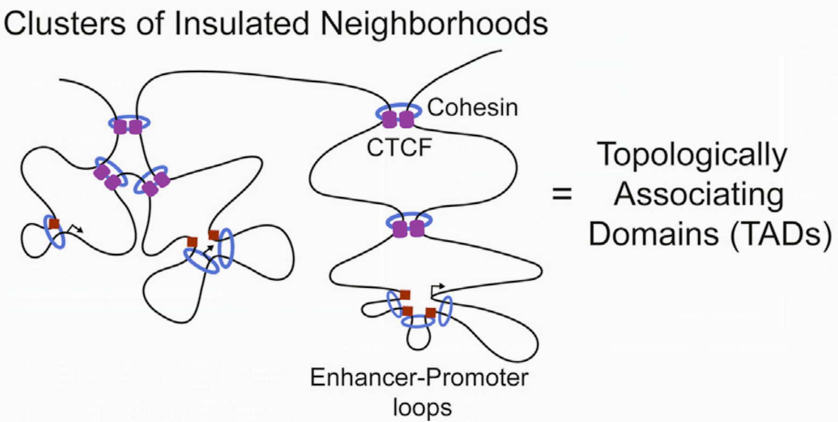
CTCF/cohesin roles in TADs
A new model for CTCF/cohesin loops in TADs was recently proposed
2 types of TAD loops:
CTCF/cohesin loops are important for structural maintenance of TADs
Cohesin-only loops are smaller promoter-enhancer loops
Ji X et al., 2016. Cell Stem Cell

Slide 23
Conclusions part 1
ElincRNAs are enriched at loop anchors
They are enriched in cohesin binding sites compared to other lincRNAs
Could be involved in enhancer-promoter looping

Slide 24
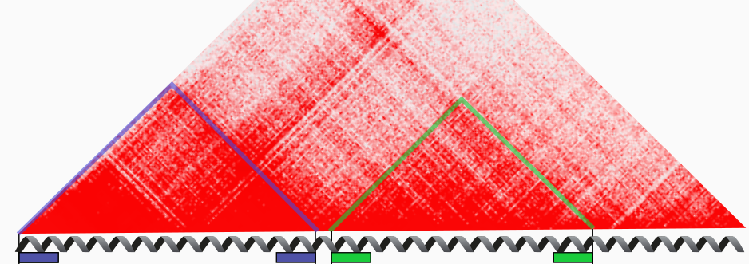
TAD boundaries
Maintaining the structure of TADs
CTCF
Cohesin
Notes:
Because CTCF and Cohesin are also known to be enriched at TAD boundaries
As I mentioned before, these bindings are involved in maintaining TAD structures
So, I next tested whether elincRNAs are enriched at TAD boundaries, this would give initial ideas to whether elincRNAs are involved in gene regulation or TAD structure maintenance

Slide 25
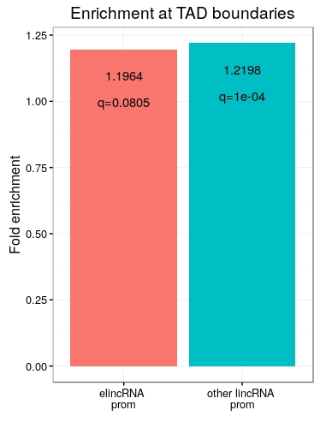
ElincRNAs are not enriched at TAD boundaries
Boundaries defined based on amount of DNA-DNA contact
Both elincRNAs and otherlincRNAs enriched at boundaries
ElincRNAs not significantly enriched compared to other lincRNAs.
1.20
q=0.08
1.22
q=1e-04
ElincRNA
prom
other lincRNA
prom

Slide 26
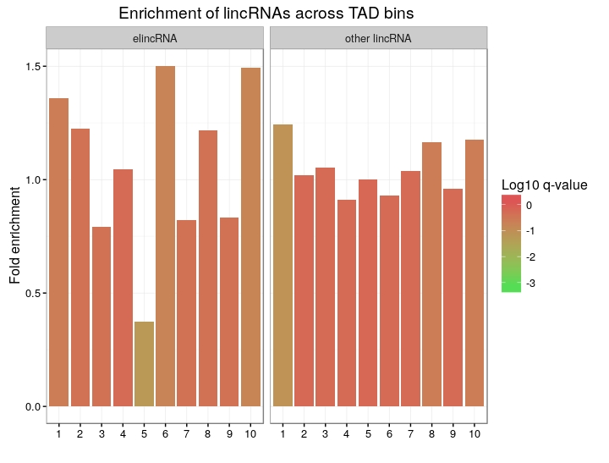
ElincRNAs are not enriched at TAD boundaries
Dividing TADs into 10 equally-sized bins.
No significant enrichment, but there is a trend.

Slide 27
ElincRNAs are not enriched at TAD boundaries
Dividing TADs into 10 equally-sized bins.
No significant enrichment, but there is a trend.
Strong depletion at the center
0.37 fold, q=0.055

Slide 28
Conclusions part 2
ElincRNAs are enriched at loop anchors
They are enriched in cohesin compared to other lincRNAs
Could be involved in enhancer-promoter looping
ElincRNAs are not significantly enriched at TAD boundaries
Likely not involved in the maintenance of TAD
Boundaries?
Or because of limitations of HiC resolution?

Slide 29
Aim 2
Are elincRNAs associated with higher chromosomal contact ?

Slide 30
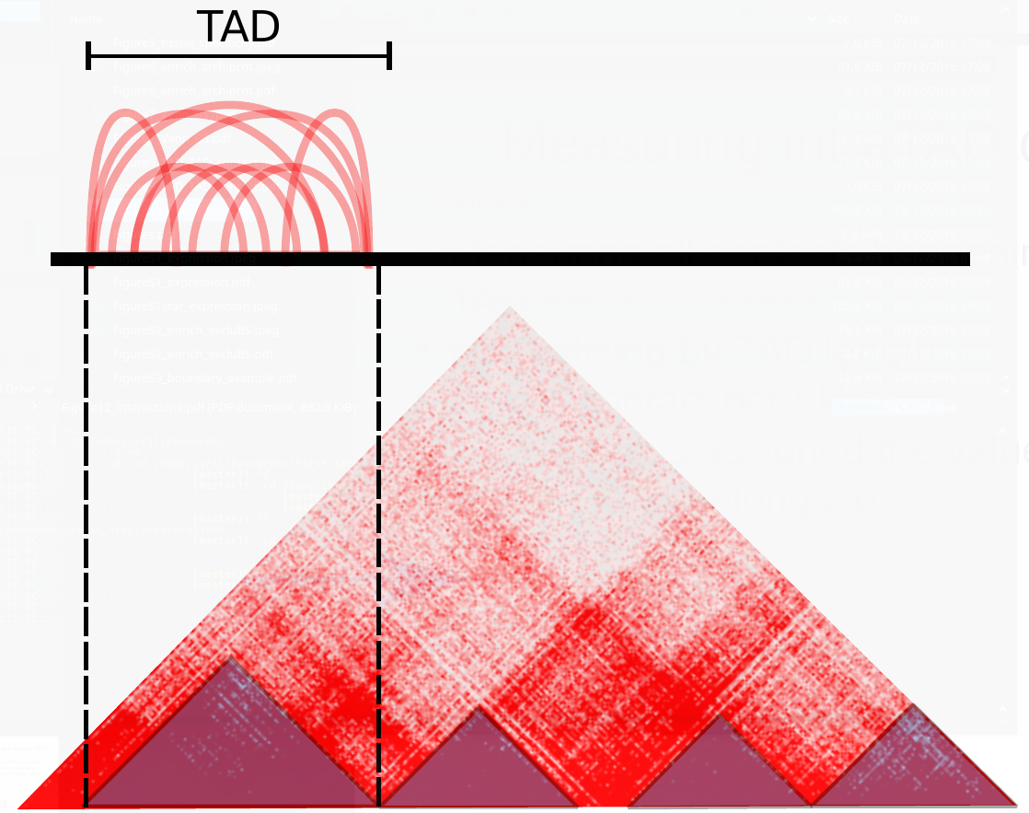
Measuring intraTAD contacts
Summing all contacts happening inside every TAD.
Normalizing by TAD length

Slide 31
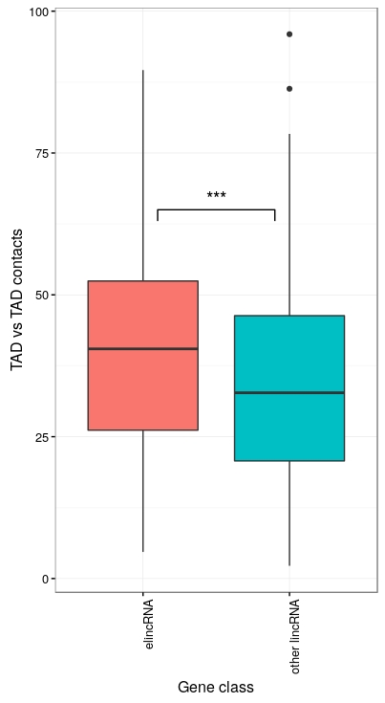
ElincRNAs associated with higher contact TADs
ElincRNAs are associated with TADs with significantly higher contact than other lincRNAs
elincRNA
prom
other lincRNA
prom

Slide 32
Conclusions part 3
ElincRNAs are enriched at loop anchors
They are enriched in cohesin compared to other lincRNAs
Could be involved in enhancer-promoter looping
ElincRNAs are not significantly enriched at TAD boundaries
Likely not involved in the maintenance of TAD
Boundaries?
Or because of limitations of HiC resolution?
elincRNAs are associated with TADs presenting more compaction
Could promote these enhancer-promoter loops

Slide 33
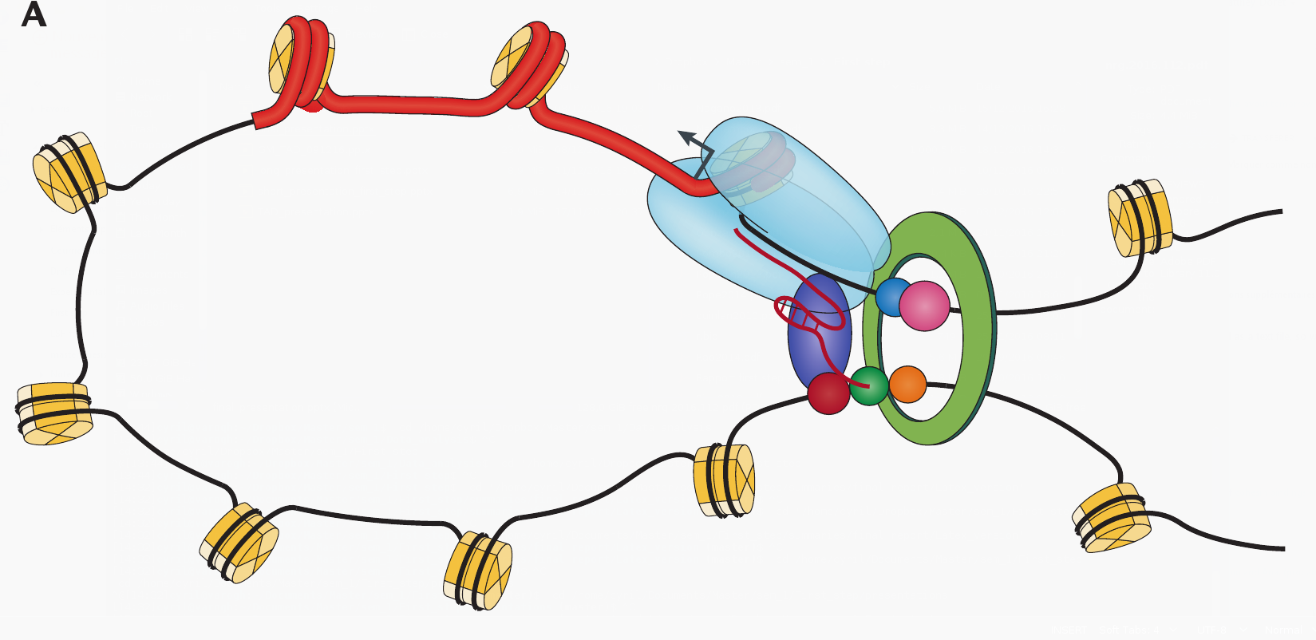
Model for elincRNA mediated promoter-enhancer looping
elincRNA
Bonev B, Cavalli G. 2016. Nat Rev Genet.

Slide 34
Outlook
Comparing enhancer with transcription of eRNAs vs elincRNAs.
Experimental validation by genetically manipulating elincRNAs transcription and testing effect on chromatin folding is required to confirm their roles.

Slide 35
Acknowledgements
Jennifer Yihong Tan
Ana Claudia Marques
Adam Alexander Smith
Maria Ferreira da Silva
Melvin Berard

Slide 36
Questions ?

Slide 37
Discussion
Ongoing debate : Transcript- or transcription-mediated functions of eRNAs in general
The mechanisms of spatial regulation by elincRNAs are probably case specific
Analysis is limited by the resolution of the technology
Only looking at intra-chromosomal contact. Interchromosomal and lamina contact might add interesting information

Slide 38
Supplementary slides

Slide 39
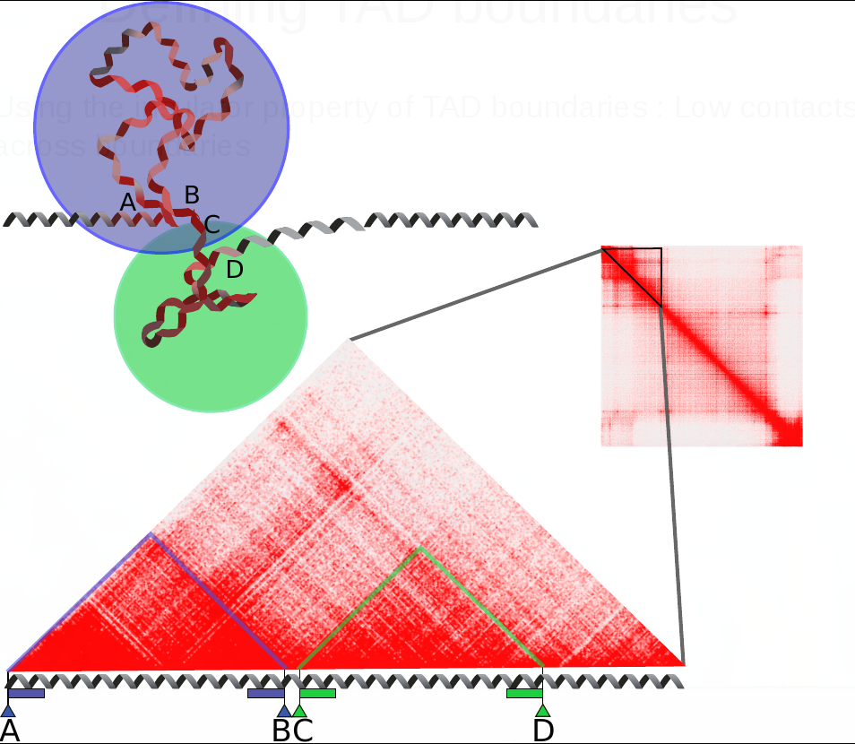
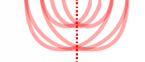
Defining TAD boundaries
Using the insulator property of TAD boundaries : Low contacts across boundaries
Extending boundaries inwards only (technical limitation)
Stop extending when the contacts reach a threshold

Slide 40
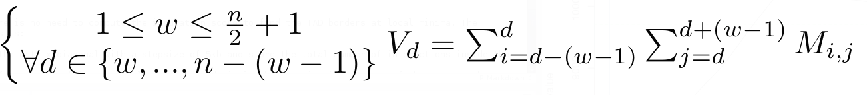
Defining TAD boundaries
Compute contacts across every position « d » in the genome at a maximum range of « w ».
Diamond of width « w » slides along the diagonal.
w : arbitrary threshold set to 100kb
V : measure of insulation for every position along the diagonal
1
n

Slide 41
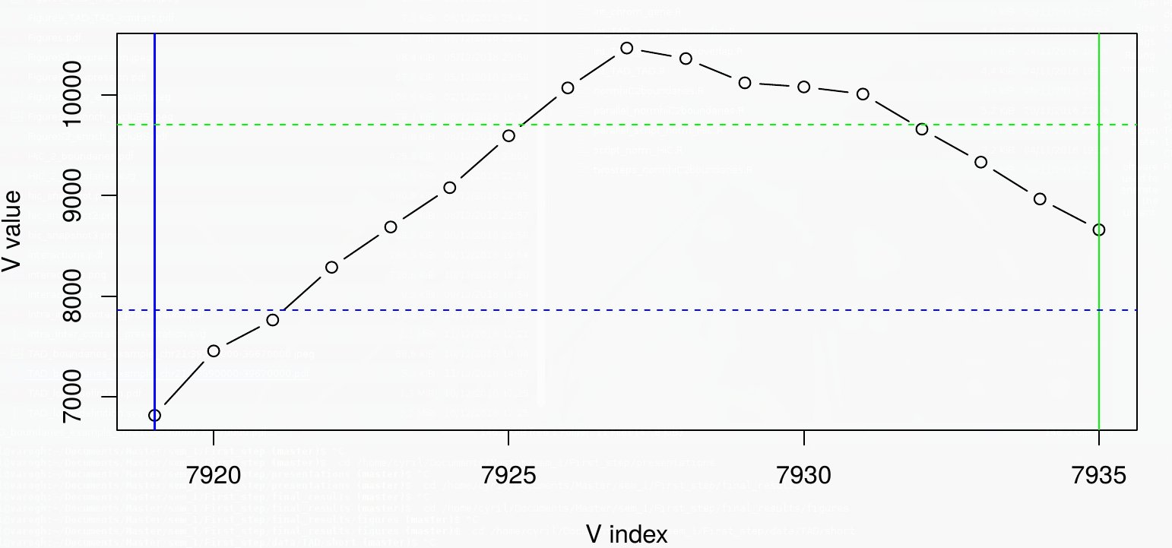
Defining TAD boundaries
For every TAD, boundaries are extended inwards from the borders until the value of V_{d} reaches a defined threshold.

Slide 42


